Slide 1
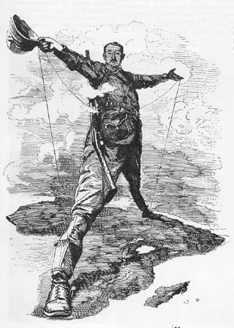
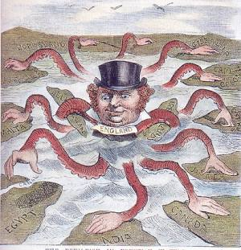
The New Imperialism

Slide 2
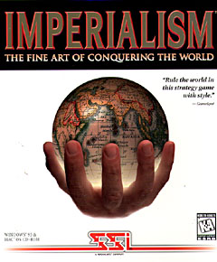
Imperialism
Imperialism – the domination by one country of the political, economic, or cultural life of another country or region – Aggressive expansion
Where have we seen Imperialism so far in history?

Slide 3
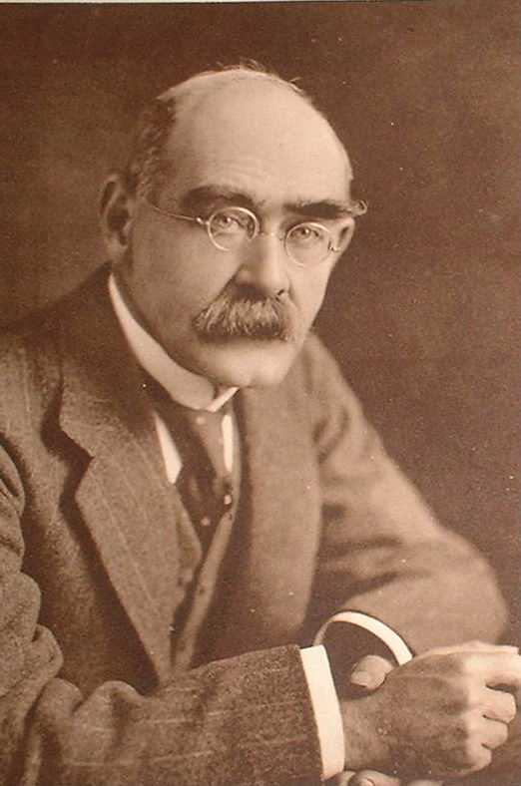
Imperialism
Causes of Imperialism
  Economic Interests
    The more area you own the more money you make
  Political and Military Interests
    Nationalism demanded that nations conquer around the world
  Humanitarian Goals
    Many felt it their duty to spread the ways of Western Civilization
  Social Darwinism
    Many embraced the idea of racial superiority
Rudyard Kipling – Author of “The Jungle Book” and the poem “White Man’s Burden”

Slide 4
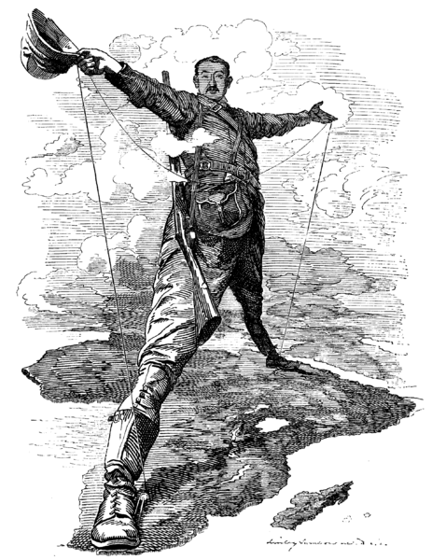
Imperialism
Slave trade decimates Africa
This causes a mad scramble to colonize Africa
  Many nations participate
    Belgium
    Britain
    France
    Germany
    Italy
    Portugal
    Spain

Slide 5
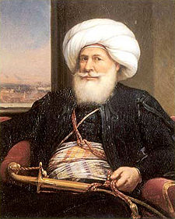
Imperialism
Egypt Seeks to Modernize
  Muhammad Ali – Governor of Egypt (1805)
    Known as the “Father of Modern Egypt”
    Improved tax collection, reorganized the landholding system, and backed large irrigation projects
    Also brought in western military experts to modernize Egypt’s army
    Dies in 1849
  Successors build the Suez Canal

Slide 6
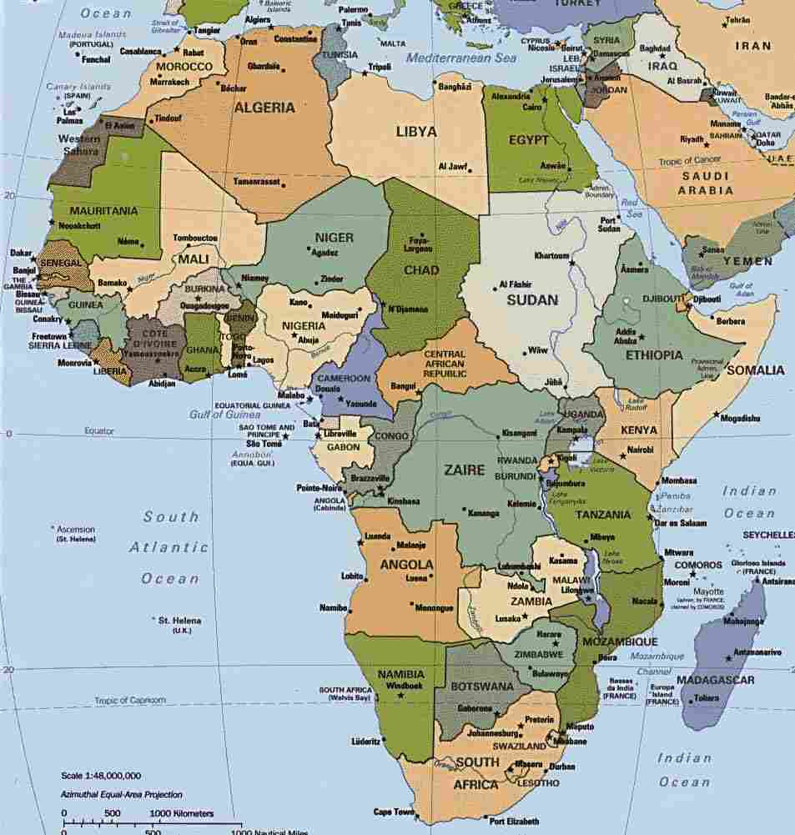

Slide 7
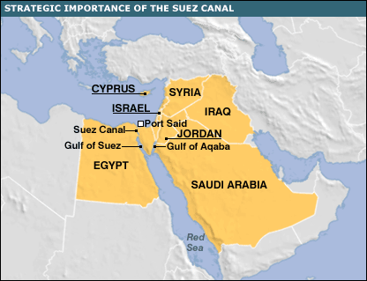
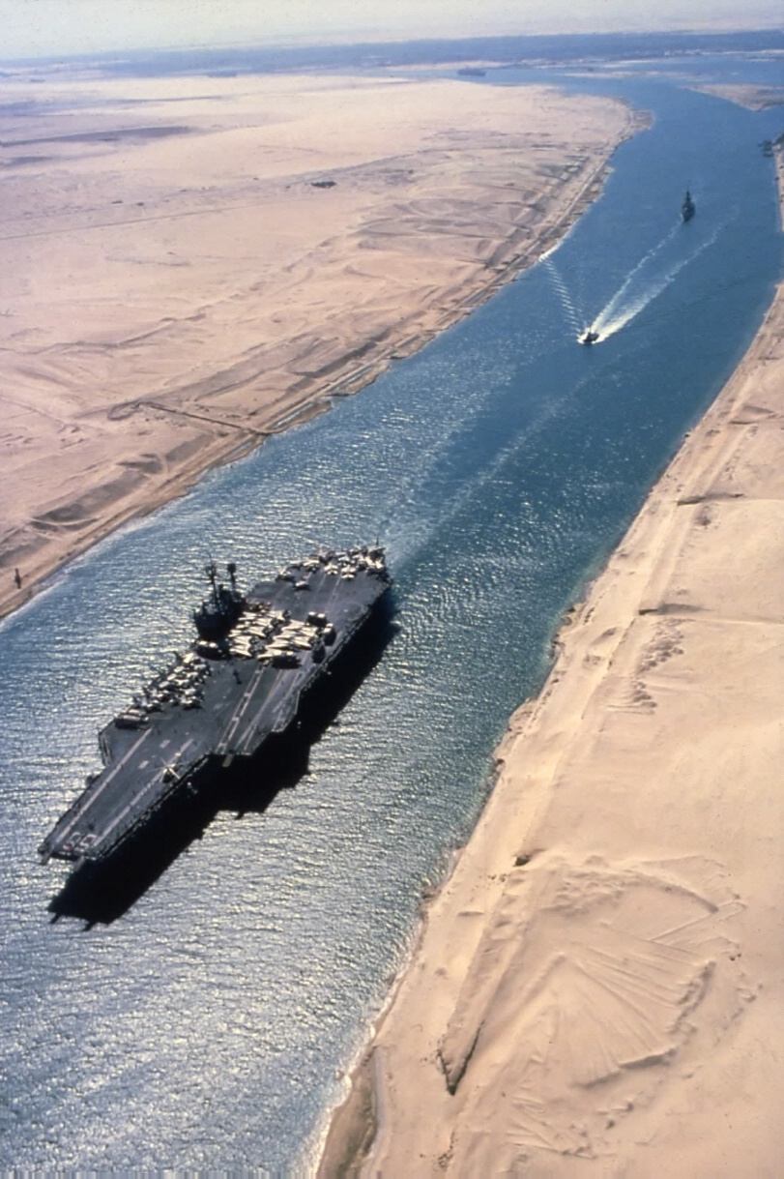
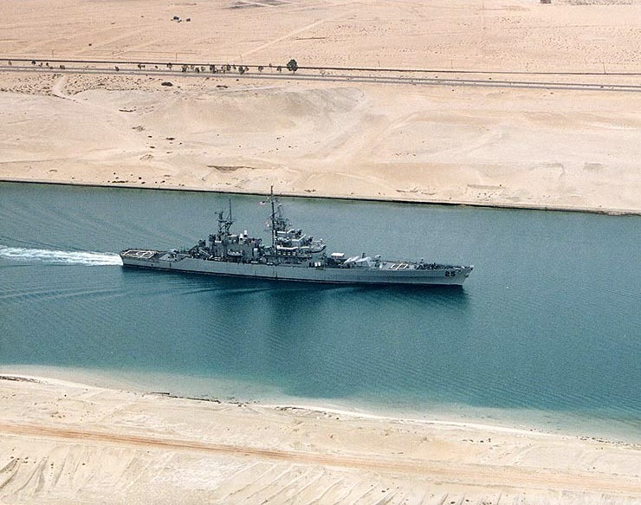

Slide 8


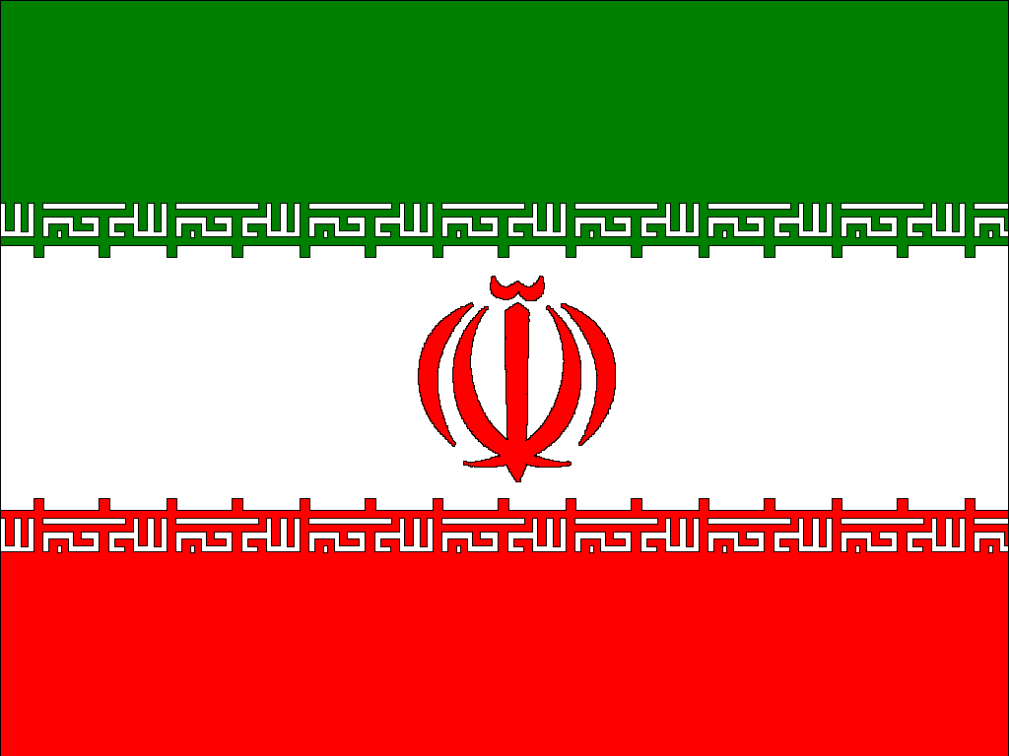
Imperialism
Iran
  Run by the Qajar Shahs from 1794 to 1925 - Pahlavi Shahs from 1925 to 1979
  Russia and Britain came into Iran and discovered oil
  Both Russia and Britain convinced Iran to grant them access to the oil
  Russian and Britain send in troops to protect their oil interests
  Iranian nationalists and Muslim religious leaders were outraged
  How does this fit into today’s current events?

Slide 9
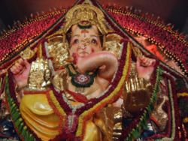
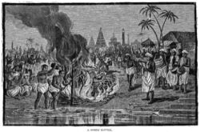
Imperialism
The British take over India
  India was home of many cultures and peoples
  When Britain came in they could not unite to prevent it
  British were in India to make money
  They tried to convert Indians to Christianity
  British also worked to end slavery and improve women’s rights
  British also sought to end the Hindu custom of “sati” – widows were expected to join their husbands in death by throwing themselves on the funeral fire
Ganesha – God in Hinduism
Sati

Slide 10
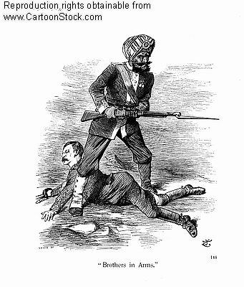
Imperialism
British required “sepoys”, or Indian soldiers to serve Britain anywhere in the world
Also allowed widows to remarry
Finally the British issued new rifles to the sepoys that required soldiers to bite off the tips of cartridges
  The cartridges were greased with animal fat either from cows (sacred) or pigs (forbidden)
  All three acts were against the Hindu religion

Slide 11
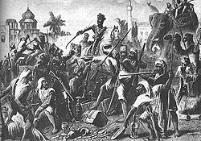
Imperialism
Sepoy Rebellion (1857)
  Sepoys massacre British men, women and children
  British send in more troops and crush the rebellion
  Took revenge for the uprising by torching villages and killing thousands of unarmed Indians
  British Parliament makes India British owned territory
  The appoint a British viceroy to rule India for the crown

Slide 12
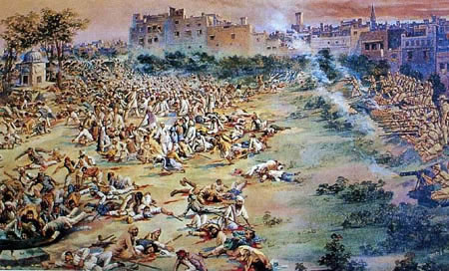
Imperialism
Amritsar Massacre (1919) – 1,100 Indians gathered into a walled field – Indian meetings were prohibited so the British commander ordered his troops to open fire, killing 379 men, women and children
Many Indians had to fight for the British in WWI
India sought self-rule

Slide 13
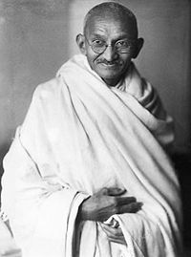
Imperialism
Mohandas Gandhi (1869-1948)
  Studied law in England
  Joined a law firm in South Africa
  Adopted the weapon of nonviolent protest and resistance
  Also known as civil disobedience or refusal to obey unjust laws
  Embraced Hindu traditions
  Inspired India to protest against British rule
  Gandhi inspired Indians to protest for their freedom from British Colonial Rule
Mohandas Gandhi

Slide 14
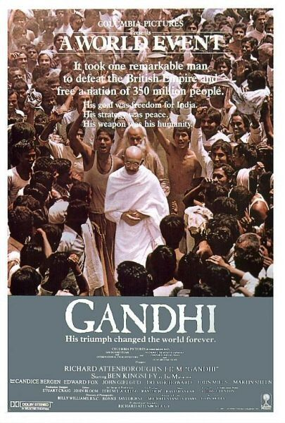

Slide 15
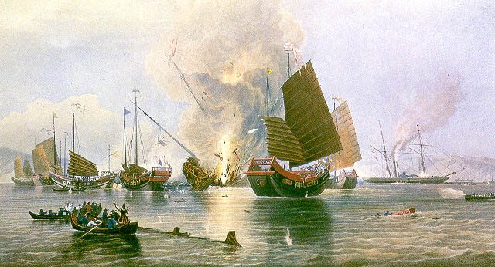
Imperialism in China
The Opium War - 1839
  Chinese become addicted to Opium
  Britain was supplying Opium to the Chinese even though it was illegal in England
  Chinese outlaw Opium and execute drug dealers
  British refuse to stop supplying China with Opium
  Chinese ships clash with British ships but are outgunned and defeated
  British force Chinese to sign the Treaty of Nanjing
    British gain Hong Kong in the treaty

Slide 16
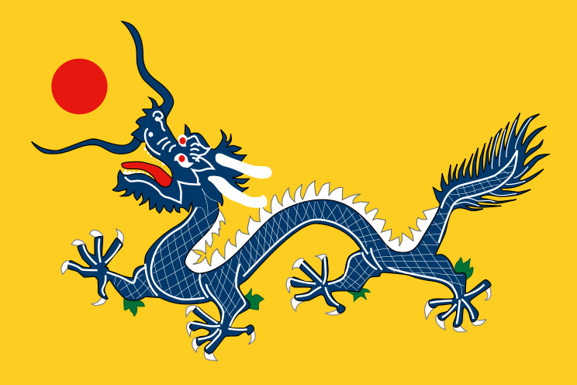
Imperialism in China
In early 1800’s the Qing dynasty was in decline
  Irrigation systems and canals were poorly maintained which caused massive flooding
This leads to the Taiping Rebellion
  20 – 30 million die in this rebellion
  Qing dynasty remains intact, but is severely weakened

Slide 17
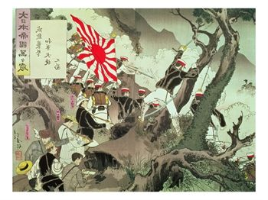
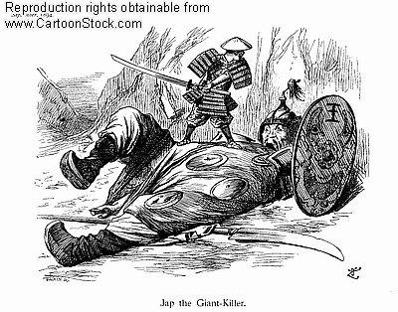
Imperialism in China
War with Japan
  Sino-Japanese War
  Japan is industrialized; China is not
  China is crushed – Western nations move swiftly to carve out areas of China
    British - Yangzi River Valley
    French – Indochina
    Germany/Russia – Northern China
    US – Stayed away
Qing Dynasty Falls

Slide 18
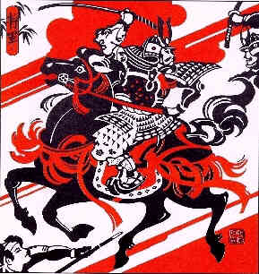
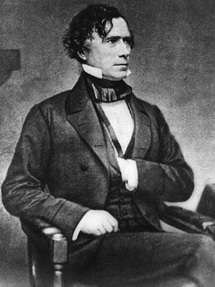
Japan modernizes
Japan had a policy of isolation
  Everything they did was internal from 1600 to 1853
  This is also the time of the Shogun and Samurai
Japan was scared by the fact that Western Powers carved up China
  Japan were worried that they would be next
In 1853 the United States sailed for Japan
  Led by Matthew Perry, they landed in Tokyo Bay and brought a letter from President Franklin Pierce demanding that they open it’s ports for diplomatic and commercial change

Slide 19
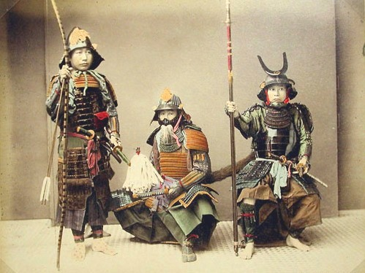
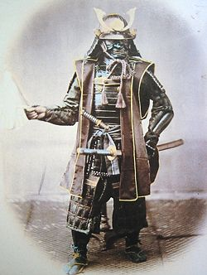
Japan Modernizes
Japan realizes that it can not defeat the United States so it gives in
  Japan signs the lopsided Treaty of Kanagawa
The Samurai revolt and appoint a new emperor
  This is known as the Meiji Restoration
  The Emperor sends his samurai to Western nations to learn the ways of Industrialized nations
  Their goal was to beat the West at their own game
  Their motto was, “A rich country, a strong military”

Slide 20
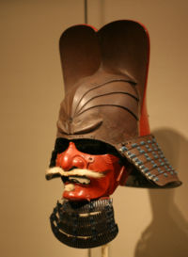
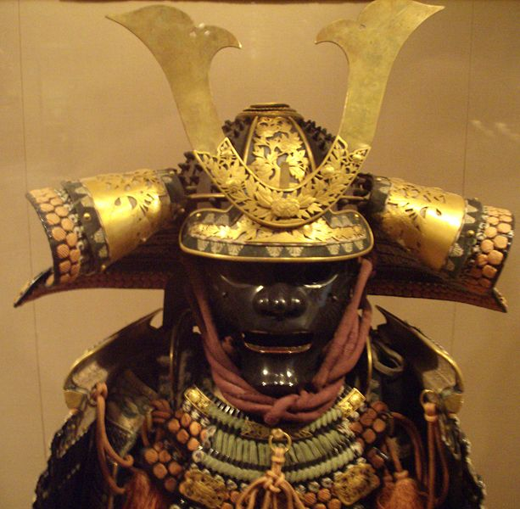
Japan Modernizes
Reforms under the Meiji
  Government
    Japan adopts the German form of government – Democracy with a ruler (emperor) having the final say
    Eliminated the special rights of the Samurai – all men were now able to be warriors in the military
  Economic
    Japan moves to modernize and build industry
    Capitalism
Japan becomes one of the most powerful nations in the world and forces Western Nations to revise lopsided treaties

Slide 21
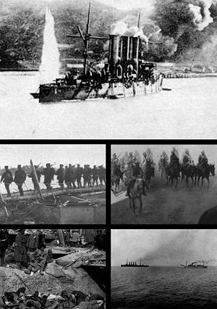
Japan Modernizes
Japan begins to seek Imperialistic goals
Japan easily defeats China in the Sino-Japanese war
Japan eventually defeats the Russians in the Russo-Japanese War
  This marks the first time in history that an Asian power defeated a European nation

Slide 22
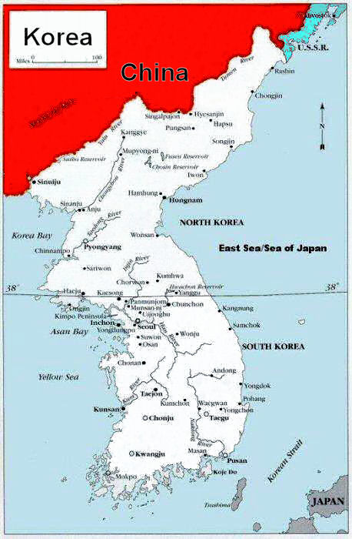
Japan Modernizes
China, Russia and Japan compete for control of Korea
Japan wins and ultimately makes Korea sign a lopsided treaty
Japan ruled Korea from 1910 to 1945
Japan industrialized Korea
Japan becomes the strongest nation in the East

Slide 23
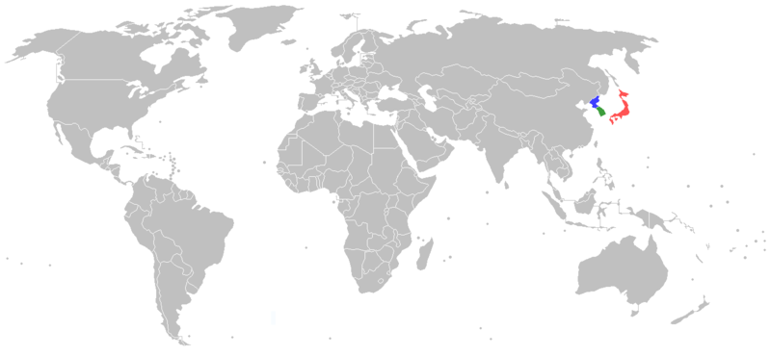

Slide 24

Southeast Asia and the pacific
Western nations fight over this area
French seize Vietnam, Laos, and Cambodia
  Rename it French Indochina
  Dutch take Indonesia
  British take Burma (modern day Myanmar), the city of Singapore and Malaya
  Siam (Thailand) survived European Imperialism – Provided a buffer zone between French and British Territories

Slide 25
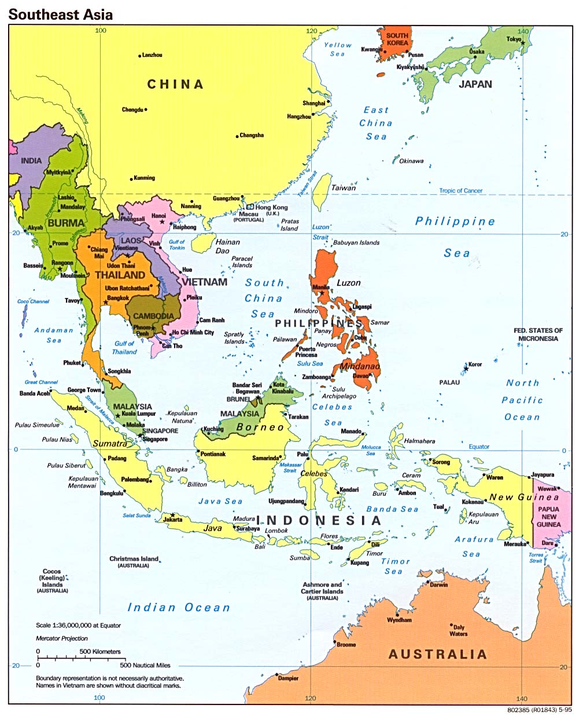

Slide 26
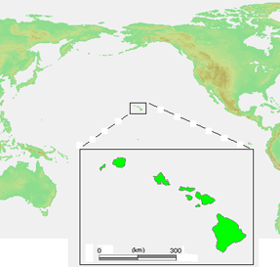
Southeast Asia and the pacific
United States makes Samoa sign an unequal treaty
United States is also interested in the sugar plantations of Hawaii – The United States annex Hawaii
The United States takes the Philippines under control after the Spanish-American War

